Slide 1
WELCOME

Slide 2
E-retail factors for customer activation and retention: A case study from Indian e-commerce customers

Slide 3
Problem Statement
Customer satisfaction has emerged as one of the most important factors that guarantee the success of online store; it has been posited as a key stimulant of purchase, repurchase intentions and customer loyalty. A comprehensive review of the literature, theories and models have been carried out to propose the models for customer activation and customer retention. Five major factors that contributed to the success of an e-commerce store have been identified as: service quality, system quality, information quality, trust and net benefit. The research furthermore investigated the factors that influence the online customers repeat purchase intention. The combination of both utilitarian value and hedonistic values are needed to affect the repeat purchase intention (loyalty) positively. The data is collected from the Indian online shoppers. Results indicate the e-retail success factors, which are very much critical for customer satisfaction.

Slide 4
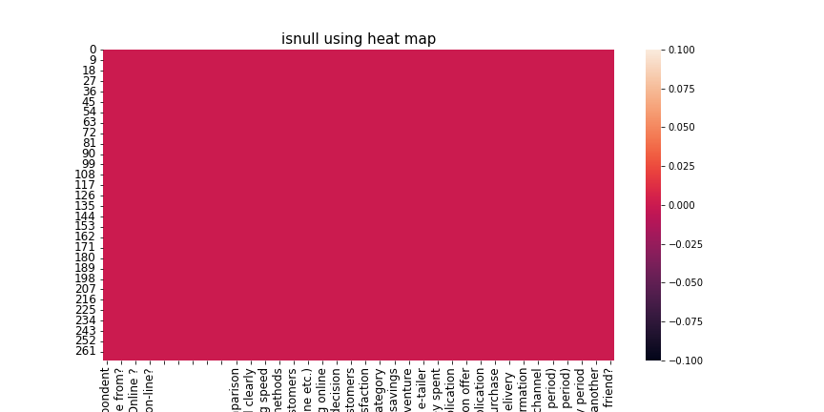
There are no null values present in the dataset. The isnull heatmap shows no lines of null and it is clear and plane.

Slide 5
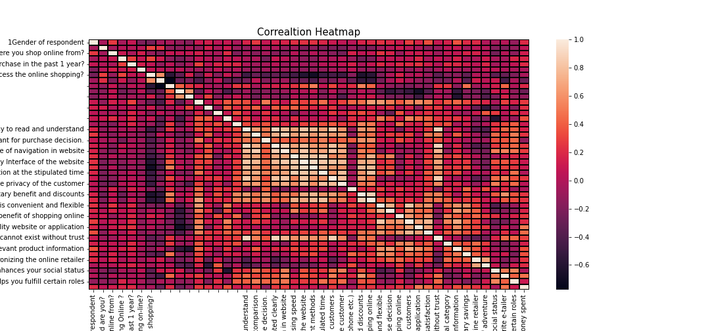
Correaltion heatmap tells the correlation between variables , the lighter the color , the morer positive correlation.

Slide 6
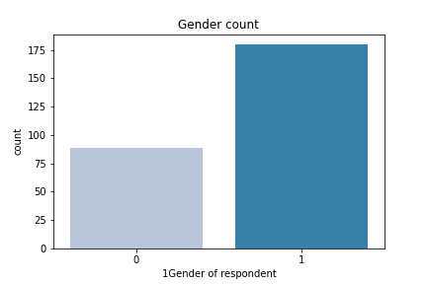
From above we can see that there are more female respondents(175) compared to male respondent(90)

Slide 7
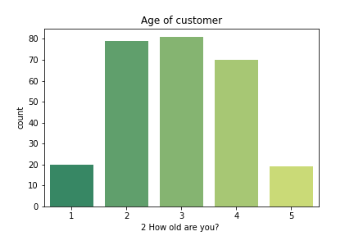
most of the customers are of age between 15 to 45 years old and only few are of age 10s and 50s

Slide 8
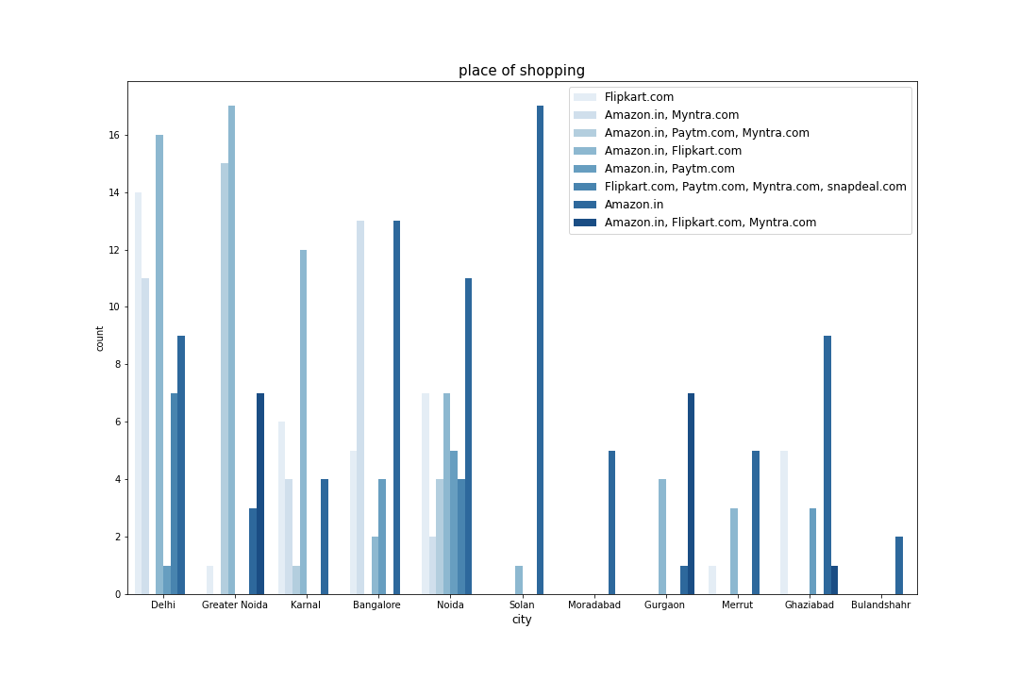
* Delhi tops the list of place of onine shopping compared to others and least number of online shoppers are from Bulandshahr and Muradabad.
* amazon and flipkart are most recommended websites in all the cities especially in Delhi, Greater Noida

Slide 9
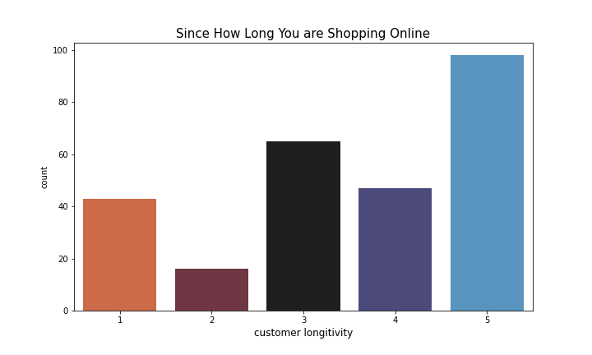
* we have around 100 customers who are shopping online since 5 years and more and they the highest in numbers compared to others and the customers who are shopping since 3 years comes in second in the list.
* From this analysis we can say that online shopping has been better compared to offline shopping.

Slide 10
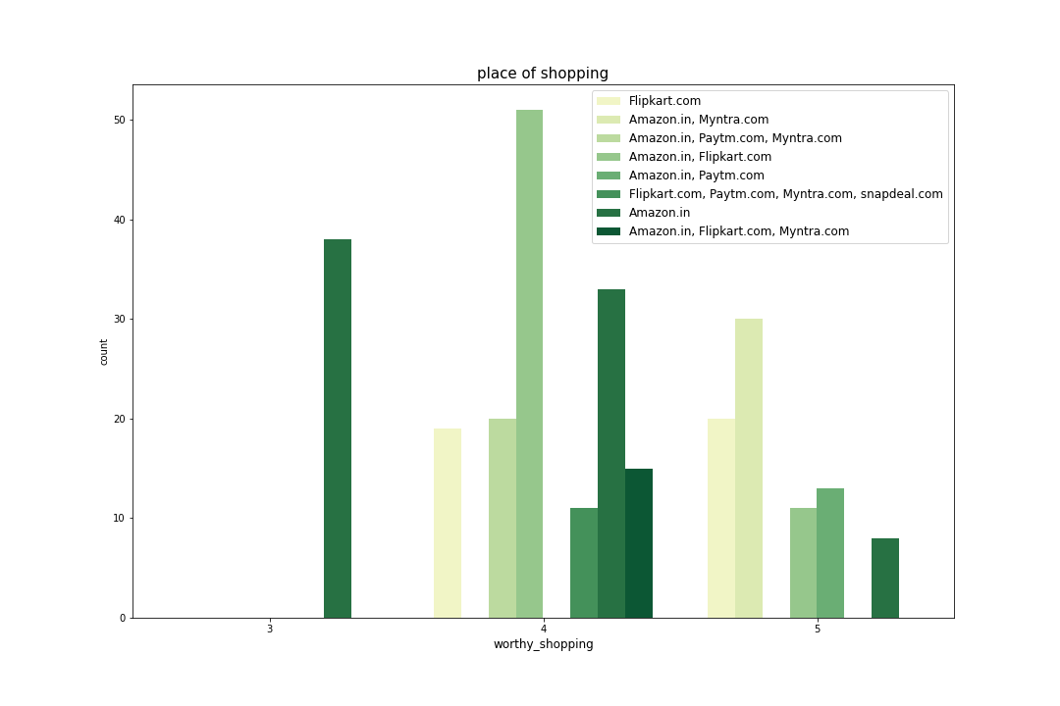
* From the above outcome we can say that amazon and flipkart are the most used online retailers by the online shoppers in India and consumers rated 4 stars out of 5 for value for mopney spent.
* amazon is the most recommended online shopping website to the friends in India.

Slide 11
Analysis
1. It is observed that there are 269 rows and 71 columns present in the dataset.
2. There are no null values present in the dataset.
3. The dataset is of object type.
4. From above we can see that there are more female respondents(175) compared to male respondent(90)
5. most of the customers are of age betweeen 15 to 45 years old and only few are of age 10s and 50s
6. Delhi tops the list of place of onine shopping compared to others and least number of online shoppers are from Bulandshahr and Muradabad.
7. Amazon and flipkart are most recommended websites in all the cities especially in Delhi, Greater Noida.
8. we have around 100 customers who are shopping online since 5 years and more and they the highest in numbers compared to others and the customers who are shopping since 3 years comes in second in the list.
9. From this analysis we can say that online shopping has been better compared to offline shopping.
10. From the above outcome we can say that amazon and flipkart are the most used online retailers by the online shoppers in India and consumers rated 4 stars out of 5 for value for mopney spent.
11. Amazon is the most recommended online shopping website to the friends in India.

Slide 12
Conclusion
From the above analysis we can conclude that Amazon and Flipkart are the most recommended, most used and most reliable online shoping websites in all the aspects.

